Slide 1
組別:A

Slide 2
資料來源: 某非營利組織之捐款資料(賀之綸提供)
分工:
data cleaning: B09702113 賀之綸 B10201054 鄭皓中
data visualizing: B09901061 莊政達 B10201051 廖羽翎
data analysis: B10201051 廖羽翎 B09901061 莊政達
making report and presentation: B10201026 許庭瑋

Slide 3
WHAT WE DO
1.data cleaning
2.data visualizing
2.data analysis
2-1 Predict whether a person regularly donates
2-2 Predict whether a person needs tax deduction

Slide 4
DATA CLEANING:
There are 16 columns in our data, but some of them are not necessary.
ex: 'payment_id' looks like a hash ,'last_status' only has ‘1’ or TRUE
Also ,there are a lot of blanks in our data.
Therefore, we need to invest significant effort in data cleaning.

Slide 5
COLUMNS WE NEED TO CLEAN
'donater_type' : 定期 or not
'uid' : classify person or company
'address' : encode XX縣/市 to int
'date' : YYYY/MM/DD to YYYY and MM
'tax' to 1 or 0

Slide 6
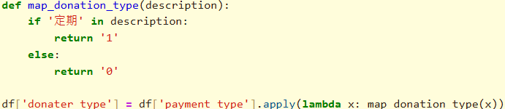
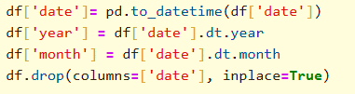
CLEANING:

Slide 7
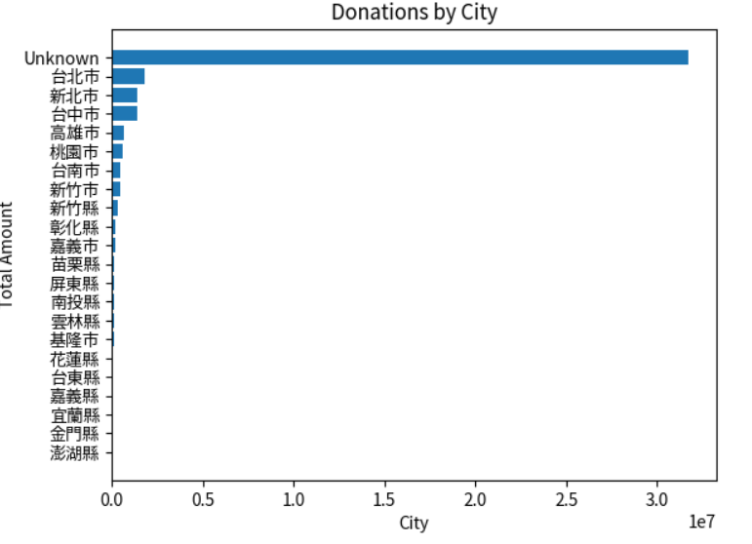
COLUMNS WITH LOTS OF BLANKS
most of data have no‘city’
so we need to fill in some data.

Slide 8
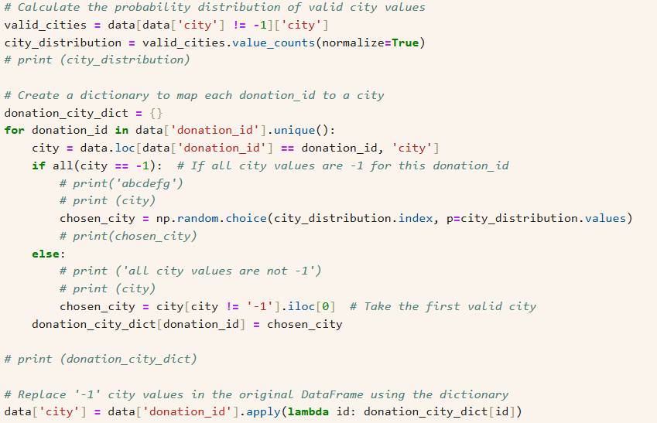
FILL IN SOME NUMBER TO AVOID NAN

Slide 9
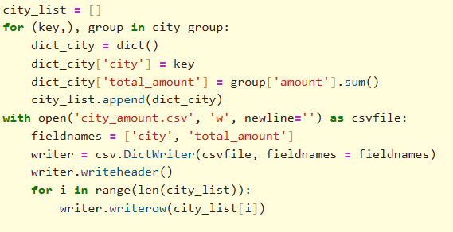
FIND FEATURES AND COUNT

Slide 10
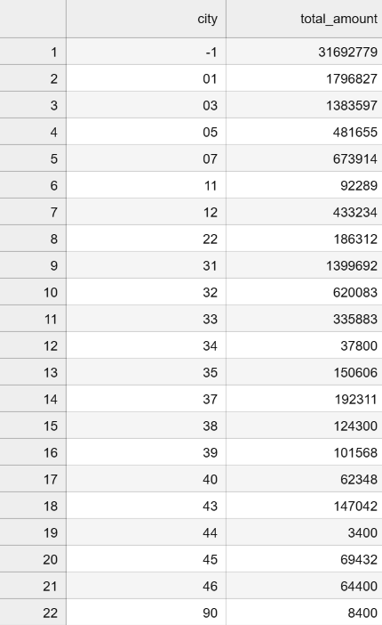
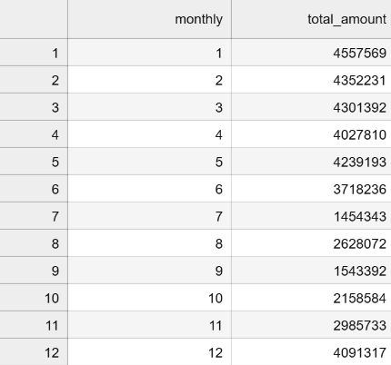
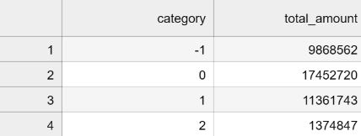

Slide 11
FINALLY WE GET A CLEAN DATA SET
columns:
1.donation_id
2.donater_type
3.category
4.year
5.month
6.amount
7.city
8.tax
9.name

Slide 12

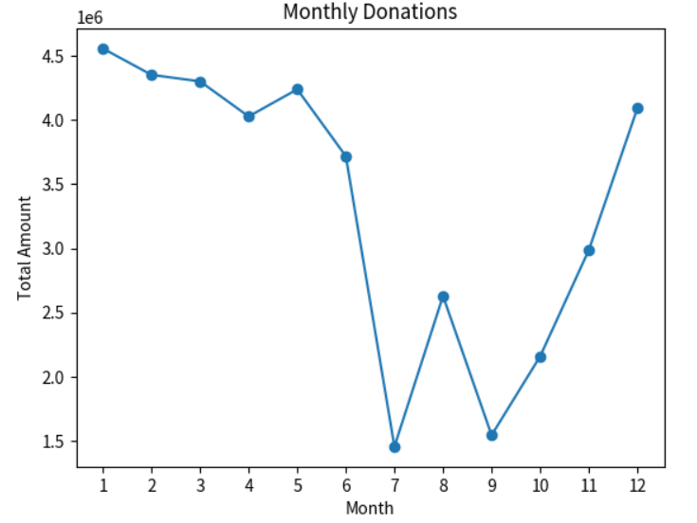
DATA ANALYSIS
draw some graphs and find what we can do

Slide 13
WHAT WE WANT TO DO
1.Predict whether a person regularly donates
2.Predict whether a person needs tax deduction

Slide 14
1.PREDICT WHETHER A PERSON REGULARLY DONATES
methods:
Decision tree , random forest , SVC , XGBoost
determine which method is the best:
find Best ratio Testing Data and Best Parameters
print sklearn.metrics.classification_report

Slide 15
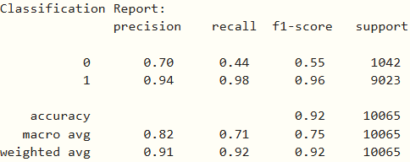
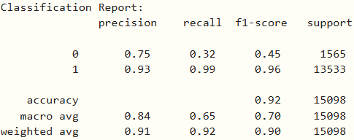
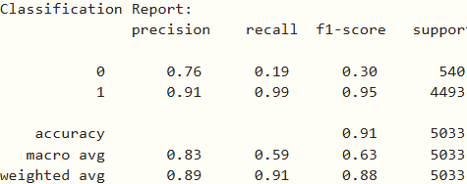
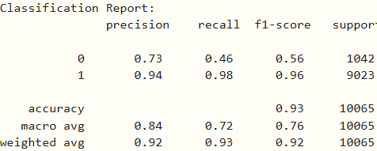
Decision tree
random forest
SVC
XGBoost

Slide 16
2.PREDICT WHETHER A PERSON NEEDS TAX DEDUCTION
methods:
Decision tree , random forest , SVC , XGBoost
determine which is best:
find Best ratio Testing Data and Best Parameters
print sklearn.metrics.classification_report

Slide 17
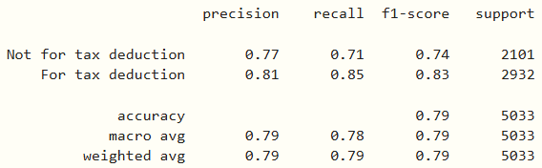
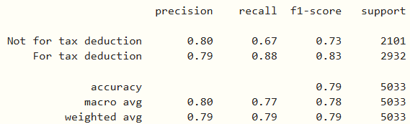
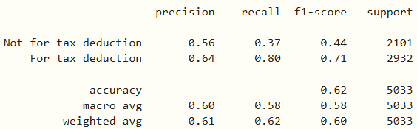
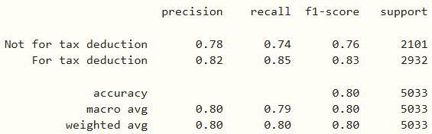
Decision tree
random forest
SVC
XGBoost

Slide 18
Thank you for listening!

